Slide 1
MEN1010
Name: Trishant Pamnani
Roll No.: B19ME086
Presentation Date: 08/01/2022
Supervisor Name: Dr. Nipun Arora

Slide 2
Project Overview
Generated binary files using tecio library provided by Tecplot and incorporating MPI for parallel processing
Built the libraries and used the compilers supported by the software
Converted the ASCII files to binary files for flow visualization
Produced the data by the processors and made the data files in parallel
Notes:
Firstly I will give a brief overview of the project. I have generated the binary files using tecio library provided by the tecplot software. We first built the libraries, softwares and compilers required to use the tecio library with MPI. Then we converted the ASCII data files provided by sir to binary as it helped in size reduction and faster processing. And at last we produced the data files within the code using parallel processing.

Slide 3
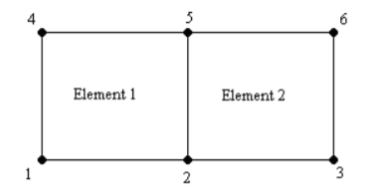
Data Structure
Two different types of data
I ) Ordered Data : points stored in a one, two, or three-dimensional array.
II ) Finite Element Data : consist of two arrays, a variable array and a connectivity matrix.
Notes:
Tecplot uses two different types of data: Ordered Data and Finite Element Data. Ordered data is a set of points logically stored in a one, two, or three-dimensional array, where I, J, and K are the index values within the array. The number of data points is the product of all of the dimensions within the array. On the other hand Finite-element data is arranged in two arrays, one is a variable array and other a connectivity matrix. The variable array is a collection of points in 2D or 3D space that are connected into polygonal or polyhedral units called elements. The connections between the nodes are defined by the connectivity matrix.

Slide 4
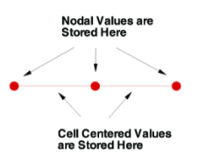
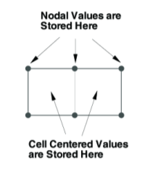
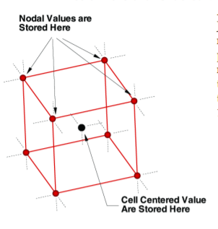
Ordered Data
• One-dimensional Ordered Data (I-ordered, J-ordered, or K-ordered)
• Two-dimensional Ordered Data (IJ-ordered, JK-ordered, IK-ordered)
• Three-dimensional Ordered Data (IJK-ordered)
(i) (ii) (iii)
Notes:
Now for this project we have used ordered data which can be classified into three types.A single dimensional array where either IMAX, JMAX or KMAX is greater than or equal to one, and the others are equal to one. For nodal data, the number of stored values is equal to IMAX * JMAX * KMAX. For cell centered I-ordered data (where IMAX is greater than one, and JMAX and KMAX are equal to one), the number of stored values is (IMAX-1) - similarly for Jordered and K-ordered data

Slide 5
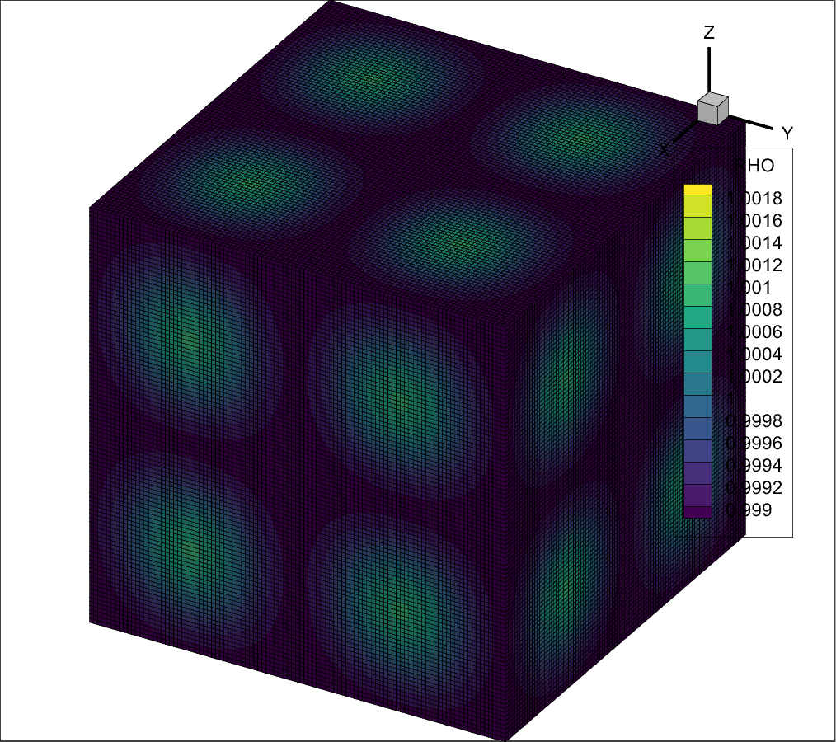
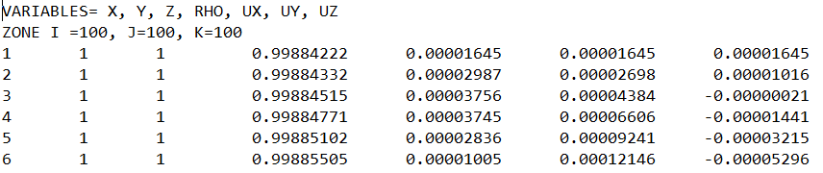
Work Done
01
Converting the ASCII format to binary files
Converted ASCII files to the binary files which led to faster visualization on Tecplot.
We used a set of functions for this, which are as follows:
  TECINI142 ( initialize the data file)
  TECZNE142 (information for the next zone to be added)
  TECDAT142 (to add the data in form of arrays to the zone)
  TECEND142 (to close the current data file)
Significant amount of time to read the big files containing millions of points
Notes:
The ASCII files provided to us were converted to the binary files which led to visualization of data points on the Tecplot software much faster(at first it took 6-8 seconds to load and later it took a fraction of a second) In the image we have the data being printed and on the right is data plotted by Tecplot
We used a set of functions for this, which are as follows:
TECINI142 is used to initialize the file in which we will write the data.
TECZNE142 is used to create a new zone for the file
TECDAT142 is used to add data to the file
TECEND142 is used to close the file
This was the not the complete solution to the problem as it took a significant amount of time for the code to read the big files containing millions of points

Slide 6
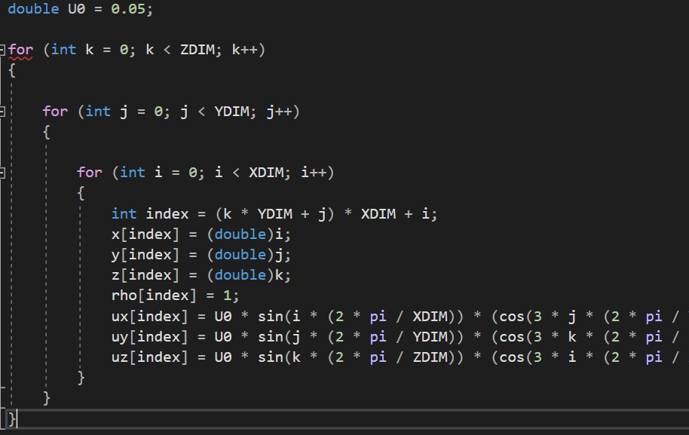
Writing the data by the processors directly to binary
02
Instead of reading, added the data from the code, leading to significant decrease in the run time of the code
Created 1D arrays for the data points using the index and directly added the arrays to the binary file
Limitations of a processor to handle such large numbers of data points
Notes:
The time to run the code significantly decreased after we stopped reading the data from ASCII and instead wrote the data by itself in the code
We created 1D arrays for the data points using the index as shown in the code and directly added the arrays to the binary file using TECDAT142 with the help of formulas provided by Nipun sir.
New challenge was the limitations of a processor to handle such large numbers of data points

Slide 7
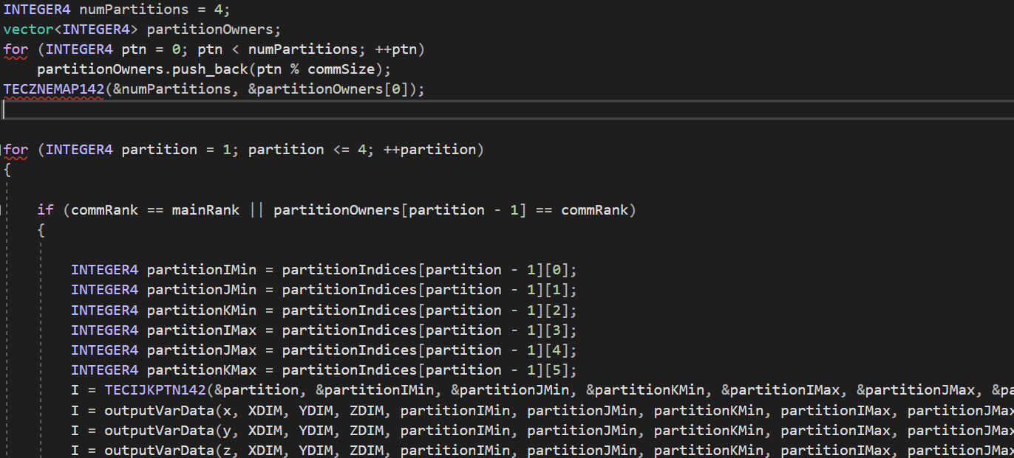
Integrating parallel processing and TecioMPI
03
Divided the data sets into partitions and each processor adds its own partition
Additional functions used here were as follows:
  TECMPIINIT142 (Initializes MPI and joins a specified MPI communicator)
  TECZNEMAP142 (it maps the processes to the partition to be printed in the zone)
  TECIJKPTN142 (manages information about partitions, later reassembled into a single zone)
The ending indices and the starting indices of the next partition should be same for TECIJKPTN142 to function properly
Notes:
The problem was resolved by dividing the data sets into partitions and letting each processor add its own partition
Additional functions used here were as follows:
TECMPIINIT142 which is used to Initialize MPI and joins a specified MPI communicator
TECZNEMAP142 which is used to map the processes to the partition they will print in the zone
TECIJKPTN142 is used to manage information about partitions, later reassembled into a single zone
TECIJKPTN142 imposes a condition that the ending indices of the previous partition and the starting indexes of the next partition should be same. So we assigned each processor a partition in a sorted order such that none of the processor must print the same data and also ensure that no partition is left unattended.

